Slide 1
Factorial of a number
data segment
x1 db 4
fact dw ?
data ends
code segment
assume cs:code, ds:data
start: mov ax,data
mov ds,ax
mov ax,0001h
mov cl,x1
call facto
jmp exit
facto proc near
mul cl
dec cl
cmp cl,01h
jz label1
call facto
label1: ret
facto endp
exit: mov fact,ax
mov ah,4ch
int 21h
code ends
end start

Slide 2
Writing and Calling Far Procedure
code segment
assume cs:code,ds:data,ss:stack_seg
……
call mul
..
code ends
procedures segment
mul proc far
assume cs:procedures
..
mul endp
procedures end

Slide 3
Factorial of a number using Far procedure
stackseg segment stack
dw 40 dup(0)
tos label word
stackseg ends
dataseg segment public
num db 5
res dw ?
dataseg ends
procedures segment public
extrn fact:far
procedures ends
codeseg segment public
assume cs:codeseg,ds:dataseg,ss:stackseg
start:mov ax,dataseg
mov ds,ax
mov ax,stackseg
mov ss,ax
lea sp,tos
mov al,1
mov ah,00
mov cl,num
call fact
mov res,ax
mov ax,4c00h
int 21h
codeseg ends
end start

Slide 4
; procedure which is called from other program
public fact
procedures segment public
fact proc far
assume cs:procedures
cmp cl,00h
jne l1
mov ah,00
ret
l1:
cmp cl,01h
jne l2
mov ah,00
ret
l2:
mul cl
dec cl
cmp cl,01h
jnz l2
ret
fact endp
procedures ends
end

Slide 5
MACRO
When repeated group of instructions is too short or not appropriate to be written as a proc.,then we use macro.
Macro is a group of instructions we bracket and give a name at the start of the program.
Each time we call macro,the assembler will insert the set of instructions in place of call.(called as expanding macro)
Assembler will generate the machine codes for the set of instructions each time macro is called.

Slide 6
Syntax: macroname MACRO
…………..
ENDM
passing parameters to macro
Syntax:
Macroname MACRO parameters
….
ENDM

Slide 7
Example:
Breath_rate proc FAR
Assume cs:procedures, ds:patient_parameters
Push_all ; macro call
Mov ax,patient_parameters ;initialize data
Move DS,AX ;segment register
Push_all MACRO
Pushf
Push ax
Push bx
Push cx
Push bp
Push si
Push di
Push ds
Push es
Push ss
ENDM

Slide 8
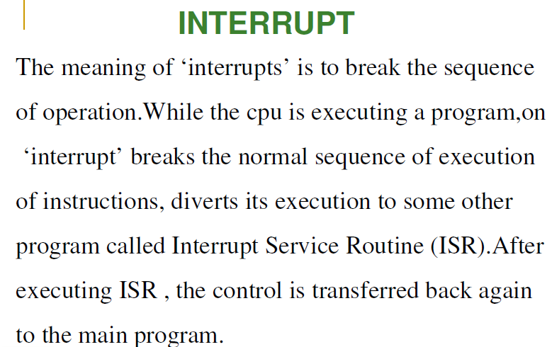

Slide 9


Slide 10
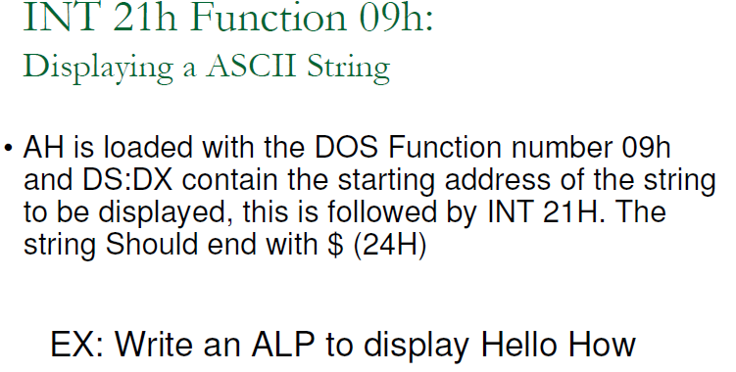


Slide 11
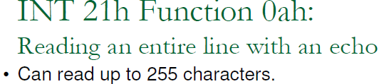
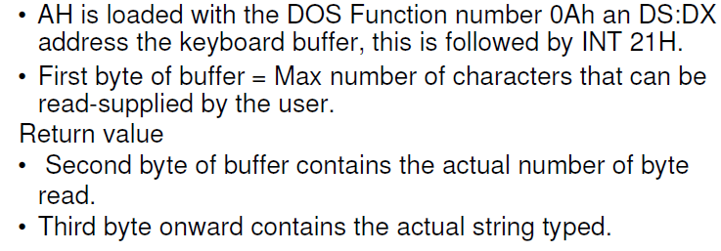

Slide 12
str1 db "Enter string:$"
str11 db 15,?,13 dup(0)
res db ?
data ends
code segment
assume cs:code,ds:data,es:data
start: mov ax,data
mov ds,ax
mov es,ax
mov dx,offset str1
mov ah, 09h
int 21h
mov dx,offset str11
mov ah,0Ah
int 21h
lea si,str11
mov ah,'$'
mov al,' '
mov bl,01h
do:
cmp [si],ah
je down
cmp [si],al
je go
inc si
jmp do
down:
jmp xx
go:
inc bl
inc si
jmp do
xx: mov res,bl
mov ah,4ch
int 21h

